Slide 1
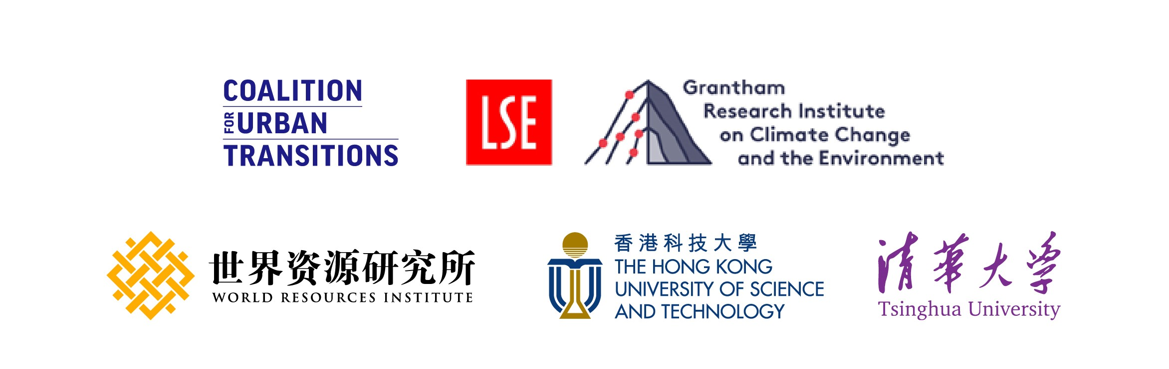
ACCELERATING CHINA’S URBAN TRANSITION

Slide 2
About the Accelerating China’s Urban Transition report
Complements Seizing China’s Urban Opportunity by delving deeper into how cities can support the country to accelerate towards high-quality growth and carbon neutrality. It provides a detailed exploration of the economic case for transforming China’s urban development model, outlines key priorities to be taken in specific sectors and sets out strategies for financing this transformation.
The report is led by the Grantham Research Institute on Climate Change and the Environment at the London School of Economics, WRI China, the Hong Kong University of Science and Technology and Tsinghua University, as part of the Coalition for Urban Transitions China work programme.

Slide 3
Accelerating China’s Urban Transition
Ch. 1: The economic case for China’s sustainable urban transformation
Ch. 2: Priority national policy actions to realise China’s sustainable urban transformation
Ch. 3: Financing the China’s sustainable urban transformation

Slide 4
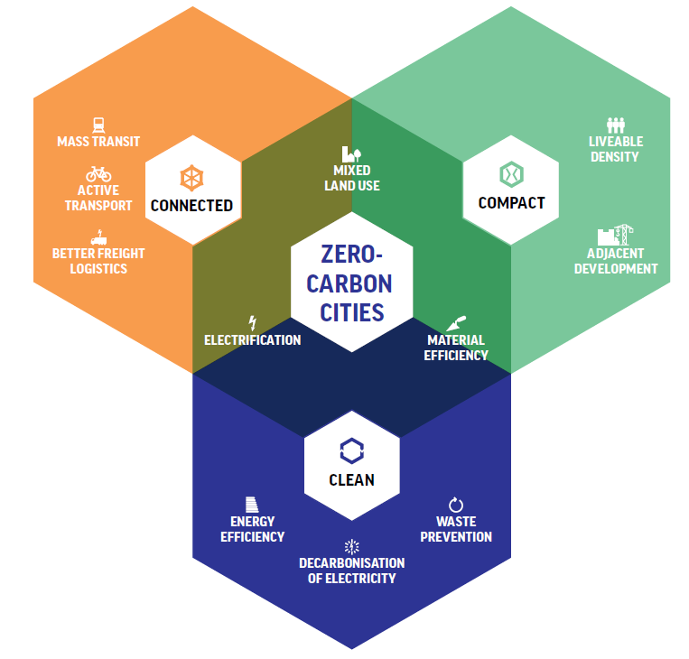
The economic case for China’s sustainable urban transformation
Ch. 1
Compact, connected and clean (CCC) cities are in line with China’s 14th Five-Year Plan’s human-centred ‘new urbanisation strategy’.
Direct cost savings: China could save up to US$1.4 trillion by pursuing more compact, connected urban growth that successfully integrates land and transport development.
Productivity and innovation: one study showed that, of 120 Chinese cities, that a doubling in city size was associated with firm productivity increases of 3 to 8 per cent.
Urban resilience: One of the most explicit policy tools to curb urban sprawl and preserve natural environments is the use of development-limiting restrictions or ‘urban development boundary’ lines.
Source: Coalition for Urban Transitions, 2019

Slide 5
Alignment with economic reforms and industry leadership potential
Ch. 1
Leadership in low-carbon urban development: If China were to make an early entry in emerging low-carbon urban infrastructure and technologies, it could secure the country’s competitiveness in the global low-carbon economy.
Weaning China off fossil fuel dependence: CCC cities can help the Chinese economy decouple from the volatility of the global oil market.
Urbanisation and regional rebalancing: …ensuring smaller interior cities are on a low-carbon development path will be crucial for China’s to meet its climate and environmental objectives.
Fossil fuel subsidies: If global fossil fuel prices were more in line with their true costs, this would lead to significant economic welfare gains of more than CNY7.8 trillion (US$1.2 trillion) per year through reduced environmental damage, increased fiscal revenues and the adoption of new sustainable technologies.

Slide 6
Recommendations for unlocking the economic potential of cities
Ch. 1
Embed the 14th Five-Year Plan’s human-centric ‘new urbanisation strategy,’ which incorporates sustainable urban development, at the centre of forthcoming sectoral and municipal implementation plans.
Include and prioritise robust indicators within the municipal government performance system that reflect and encourage the 14th Five-Year Plan’s human-centric ‘new urbanisation strategy’.
Ensure a holistic cost-benefit analysis that is consistent with principles of the human-centric ‘new urbanisation strategy’ is carried out on urban infrastructure projects.
Improve the international competitiveness of Chinese cities by systematically benchmarking their sustainable urban development progress against global peers.
Incentivize low-carbon urban development by assigning specific verifiable emission reduction responsibilities and prioritise city-level carbon inventory systems.

Slide 7
Priority national policy actions to realise China’s sustainable urban transformation
COAL-FIRED
POWER PLANTS
ENERGY
EFFICIENCY
ELECTRIC
POWER
ENERGY
BUILDINGS
COORDINATED
GOVERNANCE
RAIL NETWORK
‘NEW INFRASTRUCTURE’
TRANSPORT
DIGITAL
INNOVATION
AVOID
IMPROVE
INFORMATION
SHIFT
Notes:
Realising China’s urban opportunity will require visionary leadership from the national government. Key actions taken in the energy, buildings, ‘new infrastructure’ and transport sectors can unlock economic, environmental and social benefits, and support the majority of cities to peak their carbon dioxide emissions by 2025.

Slide 8
Coordinated governance of the environment and the economy at the city level
Ch. 2
From 2010 to 2017, Shenzhen’s carbon emissions per CNY10,000 (US$1,538) of GDP decreased by 26.3 per cent. Meanwhile, the city’s air quality has improved significantly. Shenzhen has achieved a good quality of air on 94.5 per cent of days.
Implementing interregional coordinated governance: Urban agglomerations should be the focus of the next stage of high-quality, balanced and socially inclusive economic growth.
Practical decarbonisation pathways require coordinated governance in urban areas, tailored to and aligned with local economic development goals.
Equity and inclusion should be consciously incorporated into low-carbon and resilient urban transition pathways.

Slide 9
Decarbonisation in four sectors
Ch. 2
Energy:
Tighten standards for coal-fired power plants and promoting renewable energy;
Optimise urban energy planning and promoting low-carbon urban energy consumption;
Facilitate multiple-energy-source planning by the national government while balancing the supply and consumption sides at the local level.
Buildings:
Require public buildings to peak emissions first;
Strictly enforce green building standards by requiring all new buildings to meet the Assessment Standard for Green Building (standard GB/T 50378-2019);
Support deep building retrofits for urban residential buildings;
Tighten environmental standards for energy-saving materials and require their installation in renovation projects.

Slide 10
Decarbonisation in four sectors
Ch. 2
‘New Infrastructure’:
Implement smart city development, promote the digital upgrading of traditional infrastructure;
Capitalize on the Internet of Things (IoT) to achieve higher efficiencies in delivering urban services;
Accelerate urban resilience, develop regional crisis response;
Transport:
Promote an integrated ‘avoid–shift–improve’ (ASI) green transport strategy;
Encourage multimodal transport and introduce road pricing;
Shift transport budgets to rail infrastructure: transferring freight to rail or waterways will result in the reduction of 432 million tons of carbon dioxide emissions by 2050.
Construct an integrated transport system and piloting Mobility as a Service (MaaS) in urban agglomerations.
Notes:
Mobility as a Service (MaaS) – an on-demand mobility service that integrates transport services, real-time transport information, payment and ticketing into a single digital platform, in order to meet personalised mobility needs. Residents of the urban agglomeration would thus be provided with a door-to-door travel service from departure to destination, which would encourage them to use only public transport for intercity travel.

Slide 11
Financing the China’s sustainable urban transformation
Ch. 3
Fiscal challenge: there is a gap between the country’s ambitious high-level objectives and the financing choices and priorities of municipal governments.
Municipal finance: Decades of rapid infrastructure growth have left many municipalities in deep debt. They lack own-source revenues to finance a low-carbon and sustainable transition. A multi-layered fiscal strategy is needed.
Off-budget financing vehicles: In 2015, China’s central government transferred more than CNY15 trillion of local government debt onto the official ledger through a debt swap programme, replacing implicit debts with government bonds.
Green finance: In 2016, China became the first country in the world to develop a green finance policy framework. By the end of 2020 China’s outstanding green project loans had reached around US$1.9 trillion.
Green bond: In 2015 the government issued Guidelines on Green Bonds Issuance. In 2019 China led the world by issuing green bonds worth US$55 billion.
To meet its climate goals under the Paris Agreement, China needs to spend an estimated US$20 trillion over the next three decades across all sectors.

Slide 12
Remaining Challenges
Ch. 3
Continued reliance on LGFVs: Total off-budget debt held by LGFVs had grown to more than CNY10 trillion (US$1.5 trillion) as of July 2020, back to levels similar before the debt swap programme.
Disincenvitised investors: The vast majority of banks and other financial institutions still lack the information and knowledge of climate risks to be able to grasp fully the latent market potential of green finance. Another challenge is the long preparation and investment cycles.
Greening special purpose bonds: In 2020, CNY3.75 (US$580 billion) of special purpose bonds were issued. However, most of these bonds ended up in more traditional, energy-intensive sectors. In 2021, the central government plans to issue CNY3.65 trillion (US$560 billion) special purpose bonds. It is imperative to include minimum environmental thresholds for a certain percentage of projects.
Green bond: Many of sustainable assets have not yet been standardised or categorised. Investors have difficulties in identifying sustainable assets and projects.
Notes:
Despite aforementioned measures, challenges remain
Greening special purpose bonds: In 2020, CNY3.75 (US$580 billion) of special purpose bonds were issued. However, most of these bonds ended up in more traditional, energy-intensive sectors. In 2021, the central government plans to issue CNY3.65 trillion (US$560 billion) special purpose bonds. It is imperative to include minimum environmental thresholds for a certain percentage of projects.

Slide 13
Recommendations for financing the urban transition
Ch. 3
Stabilise municipal financing through own-source revenues. Local tax measures include a beneficiary property tax, a piggyback tax on the personal income tax and a national carbon tax with a piggyback tax.
Prioritise strengthening systems for data collection and data sharing and enable the monitoring of performance and progress of low-carbon investments.
Include minimum environmental thresholds for projects funded by special purpose bonds. Connecting special purpose bonds with goals for sustainable urban development can be introduced and phased in incrementally.
Scale up environmental information disclosure.
Develop a clear taxonomy system for green bonds that defines the difference between sustainable and ‘brown’ projects or infrastructure.

Slide 14
Summary of Opportunities for Action
Putting sustainable cities at the heart of implementation of its investment plans, Nationally Determined Contribution (NDC), and recently unveiled Five-Year Plan (FYP), and with the aim of peaking emissions in most urban areas by 2025. The FYP’s massive investments alone will shape China’s trajectory for years to come.
Embedding the 14th FYP's human-centric 'new urbanisation strategy' at the centre of forthcoming sectoral and municipal implementation plans.
Enhancing energy efficiency in the buildings sector through enforcing green building standards and supporting deep building retrofits.
Supporting small and mid-sized cities. Foster sustainable development, transform mobility and accessibility, and improve inter-regional equity.
Developing stable own-source revenue streams at the municipal level.
Incorporating decarbonisation and resilience objectives, including nature-based solutions, in national urban design and regeneration strategies.
Notes:
This summary includes recommendations from ‘Seizing China’s Urban Opportunity’ as well.
https://coalitionforurbantransitions.org/en/publication/seizing-the-urban-opportunity/seizing-chinas-urban-opportunity/

Slide 15
THANK YOU!

